Slide 1
Data-Based Marketing
Team-4

Slide 2




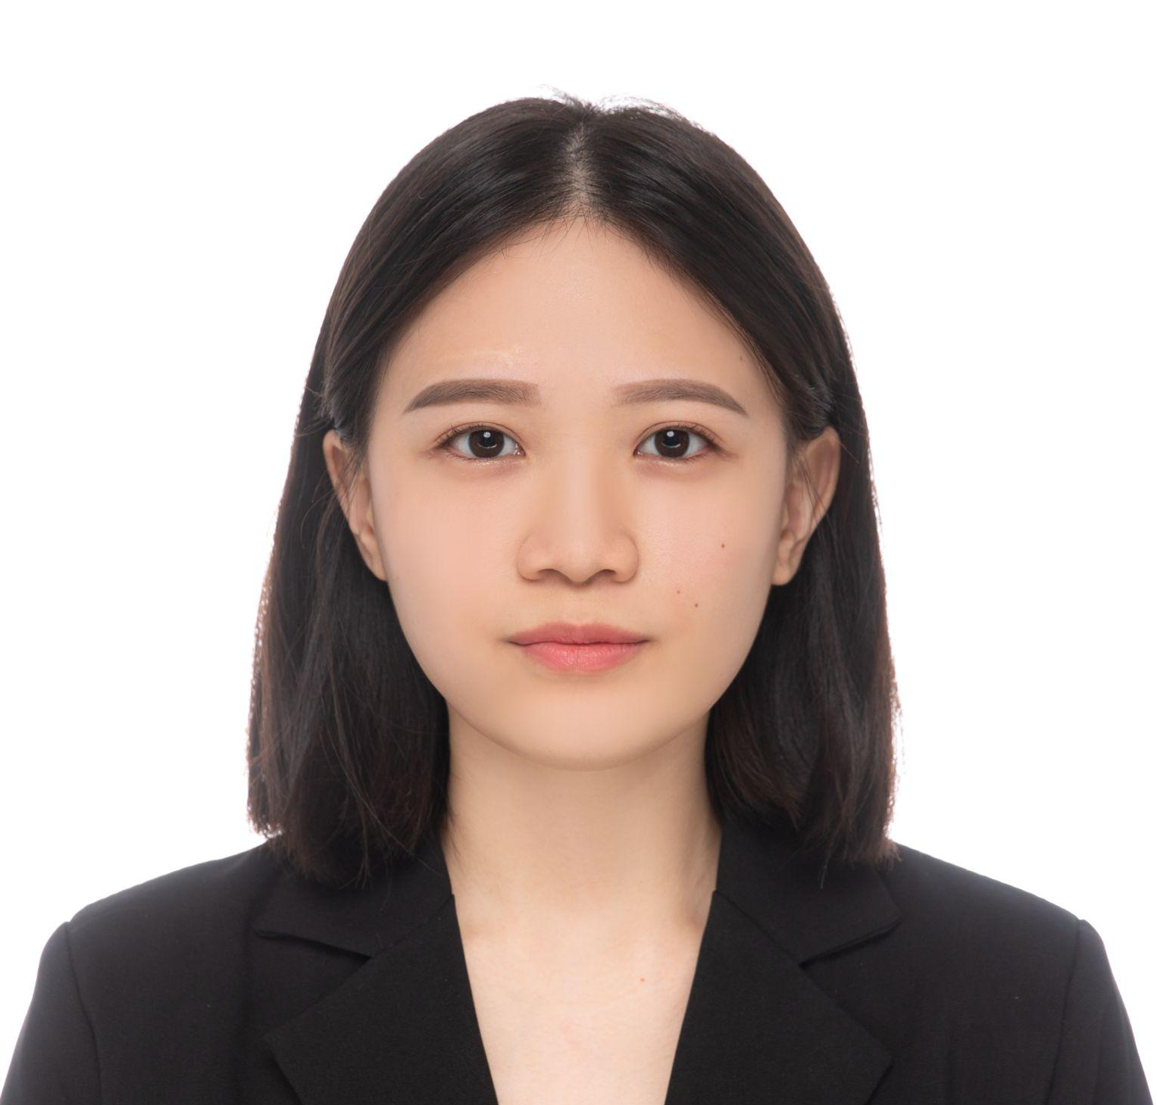



Team Members
Cooper Keillor
Pedro Vallejo
Qingyang (Tony) Zhang
Will Au
Ya-Fang Hsiao
Ella Williamson
Sam Horvath
Varun Anand
Notes:
Each introduce themselves

Slide 3
Outline
A glimpse at the data
The premise - setting our goals
Utilized methods
Interesting Findings and Decisions throughout
Conclusions
Notes:
-Tony

Slide 4
Data Exploration - Numerical Variables
Age
Mother’s Education
Father’s Education
Siblings
Family Size
Self Esteem
Marital Status
Height
Weight
Income
Education
Weeks Employed
Number of Spouses
Notes:
Ella
First, briefly talk about what our data set actually is. Maybe explain what some of these are - the unintuitive ones, like self esteem, weeks employed, marital status.
https://prod.reader-ui.prod.mheducation.com/epub/sn_b855/data-uuid-6c433b6969b94116a3262968e9b4e202#data-uuid-814fa1a98aa241b5a180d4e2f617e84c

Slide 5
Data Exploration - Binary Variables
Urban
1: Urban Area, 0: Non-Urban Area
Black
1: Black, 0: Non-Black
Hispanic
1: Hispanic, 0: Non-Hispanic
White
1: White, 0: Non-White
Christian
1: Christian, 0: Non-Christian
WomenPlace
1: Agree, 0: Disagree
Male
1: Male, 0: Female
Outgoing Kid
1: Outgoing, 0: Shy
Outgoing Adult
1: Outgoing, 0: Shy
Health Plan
1: Yes, 0: No
Notes:
Sam:
Don’t need to read out every single variable in presentation. - explain what Health Plan and Urban mean.
https://prod.reader-ui.prod.mheducation.com/epub/sn_b855/data-uuid-6c433b6969b94116a3262968e9b4e202#data-uuid-814fa1a98aa241b5a180d4e2f617e84c

Slide 6
Setting up our Business Questions
Target Variable
Income - given different pieces of information about an individual, are we able to predict their income?
Why income?
We are acting as a bank, who desires to advertise a loan program to potential clients. We want to make the best use of our marketing budget, and target groups of people with high expected income.
Secondary Purpose
For potential clients, we want to determine whether we can predict if people have health plans, in order to potentially advertise our HSA accounts to them.
Notes:
-Ya Fang Hsiao

Slide 7
Data Mining Methods
Linear Regression & Decision Trees - Primary Methods
Can we predict income of an individual we may have other information about?
Non-Linear Regression
Can we improve upon the power of our model to explain the variation in our data?
Classification Trees
Which groups of individuals likely do not have an HSA?
KNN
Can we build a model to predict whether an individual has a HSA?
Notes:
Varun
Focus on Linear Regression, Decision Trees, and Classification Trees.

Slide 8
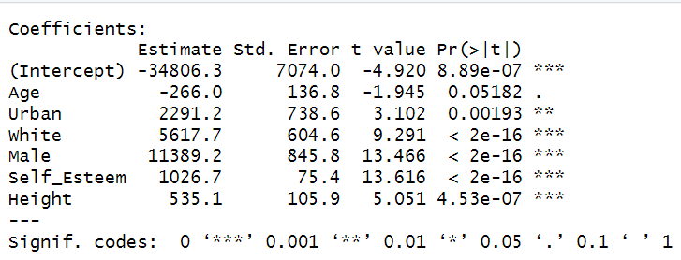
Linear Regression Analysis - Can We Predict Income?
Age as a Predictor: Analysis suggests a weak link between age and income, with age showing only a modest influence on earnings.
Impact of Urban Living: Living in urban areas is strongly associated with higher income levels, highlighting the economic advantages of city life.
Influence of Race and Gender: The variables 'white' and 'male' demonstrate a very significant and positive correlation with income, indicating notable demographic disparities.
Height and Income Correlation: While height is a consistent predictor, its effect on income is present but not particularly strong, suggesting subtler socio-economic influences at play.
Self-Esteem's Strong Role: Above all, an individual's self-esteem score emerges as the most powerful predictor of income, underscoring the importance of psychological factors in economic success.
Notes:
Pedro
Speakers notes:
When discussing age, emphasize that while there's a moderate correlation with income, the statistical evidence is not strong enough to consider age a robust predictor. Mention that the p-value is just above the commonly used significance threshold of 0.05.
Explain that urban living has a positive and statistically significant relationship with income. This means that, after controlling for other factors, individuals living in urban areas tend to earn more.
Highlight the significance of race and gender in the analysis, pointing out that being white and male has a very significant positive association with income in the data examined. This could point to systemic issues in the job market that may warrant further investigation.
For height, note that while it is a consistent predictor of income, the effect size is not particularly large. It's an interesting finding that suggests physical attributes may have some impact on earning potential.
Finally, explain that self-esteem had the strongest association with income in the model. This suggests that psychological factors may be powerful in determining economic success, which aligns with literature that links self-confidence to career advancement and negotiation skills.

Slide 9
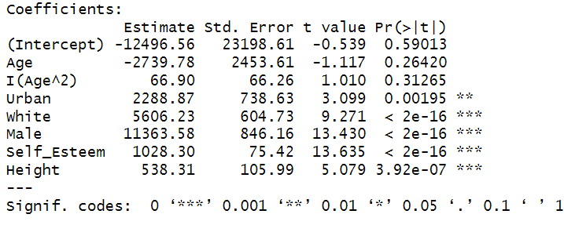
Improving our model - Non-linear Regression
New Regressions
Coefficients introduced:
Age^2
Not Significant
Self_Esteem^2
Not Significant
Male^2
Not significant
Significance across models
Many of our variables remained significant, reinforcing their importance
Notes:
Tony
The coefficient is not statistically significant. While our regression has not proven the relationship between age and income to be non-linear, that doesn’t mean the variables are uncorrelated.
We did non-linear analysis in order to see if could capture a higher fraction of the variation in our data by discovering a non-linear explanatory factor, but we did not find one.
We ran a few different non-linear regressions, each time introducing a different quadratic term.

Slide 10
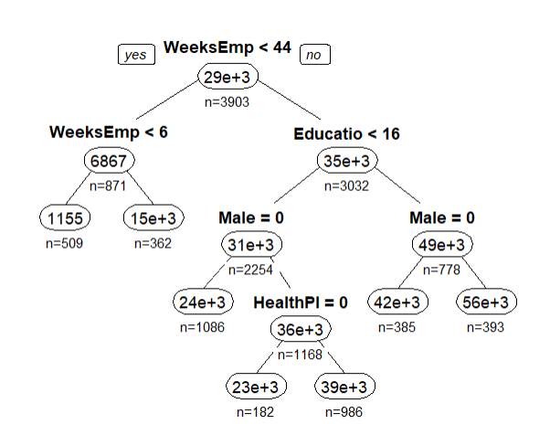
Groups of Interest - Loan Program
Best Pruned Tree
Top Targets
Educated men with consistent employment history
Women also a strong target
Who to omit
People who are unemployed
People with low levels of education
People without health insurance
Notes:
Will

Slide 11
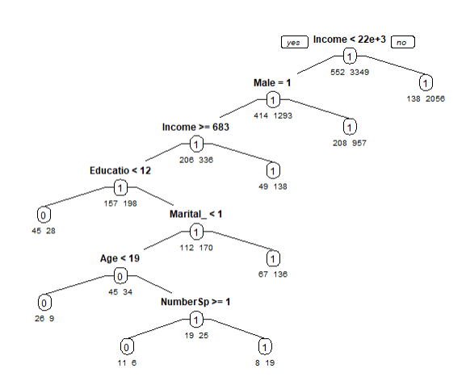
Potential HSA targets
Top Targets
Low income males who do not have their high school diploma
Low income males who are not married
Who to omit
People with a high income
Women
Likely not worth advertising to minors.
Notes:
Will

Slide 12
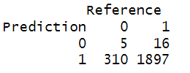
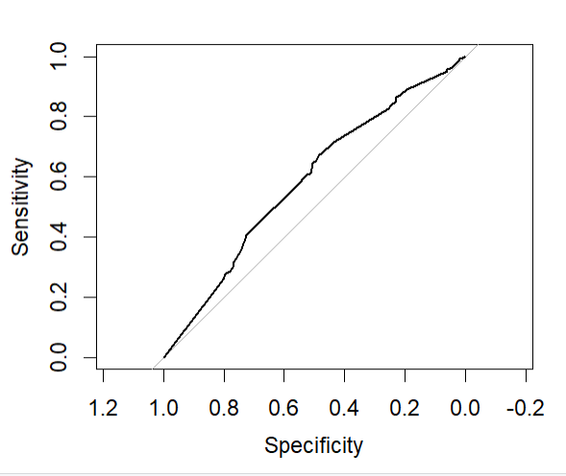
KNN
KNN modeling proved relatively unsuccessful.
Poor AUC value
Very low specificity
Model tends to overpredict individuals to have a health plan.
Uses
Our KNN model may be helpful to further verify individuals who we already suspect to have a HSA
Notes:
-Cooper
We gave KNN a try and found it not to be super helpful. - very brief

Slide 13
Conclusion
Utilized several different types of data analysis to empower management to make business decisions.
Identified characteristics of high income individuals that may be useful for marketing
Discovered target groups that may be interested in and qualified for a loan program
Found target groups that may be interested in an HSA
Built models for predicting whether an individual we have some information about is likely to already have an HSA
Notes:
Sam

Slide 14
Thank you!

